Slide 1









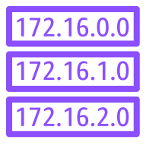




AWS Cloud
Availability Zone A
Availability Zone B
Virtual private cloud (VPC)
192.168.0.0/16
Internet gateway
Public subnet
Public subnet
192.168.1.0/24
192.168.0.0/24
NAT Gateway
Application Load Balancer
Bastion Host
S3
AutoScaling Group
WebServer01
WebServer02
App subnet
App subnet
192.168.10.0/24
192.168.11.0/24
Amazon SNS
Client Linux VM
Client Win VM
DB subnet
192.168.20.0/24
DB subnet
192.168.21.0/24
Elastic network interface
Endpoint

